Slide 1
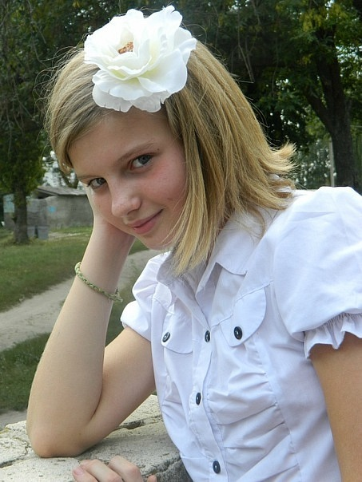
Mass Media in our life
Project Work
Serdiuk Yelyzaveta and
Yana Plotnikova
Form 8-A
Gymnasium №1

Slide 2
My name is Yelyzaveta .My surname is Serdiuk. I am thirteen. I live in Barvinkove. I live in Lenin Street. I study at Gymnasium №1. I am in the eighth form. I have many hobbies. They are: writing long stories, reading interesting books , drawing beautiful pictures and embroidering. Especially I like to meet and speak with my friends, to play on computer, to listen to music, to travel, to read newspapers or magazines and to ride a bike.

Slide 3
Mass Media in our life
My name is Yana. My surname is Plotnikova. I am twelve. I live in Barvinkove too. I also study at Gymnasium №1 in the eighth grade. My hobbies are very different. I like to dance, to sing beautiful songs, to listen to music, to work in the Internet and to go for a walk with my friends.
We want to tell you about the role of Mass Media in our life.

Slide 4
important role in our life
to help to form our opinion
on different events inform about different even
different pictures,
Photographs, illustrations Mass Media
entertain people
to carry state and
local news help to make their lives
better
unusual events
sensational events
natural disasters
crimes

Slide 5
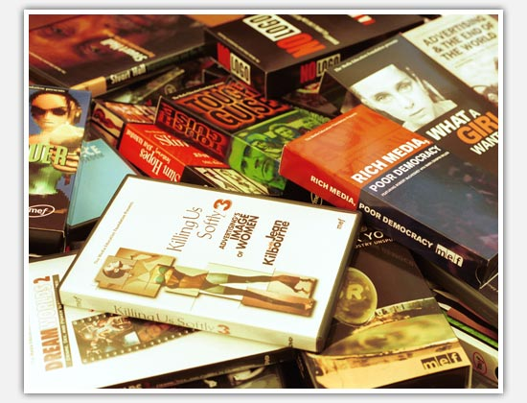
Mass media play a very
important role in our everyday
life. They serve to inform
people about different events
that take place or may
happen. They also entertain
people or even help to make
their lives better.

Slide 6
Sensational events such as
crimes, natural disasters
or unusual events are also
of great interest. That is why many newspapers and TV programmes combine them with serious information. Usually daily mass media carry some international , state and local news.

Slide 7
They also contain some other topics like health care, arts and so on. A lot of newspapers have advice columns, review of books, comics, crossword puzzles, etc. Most of them have different pictures, photographs
and illustrations.

Slide 8
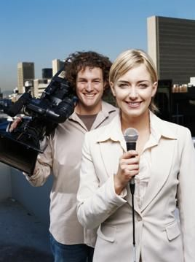
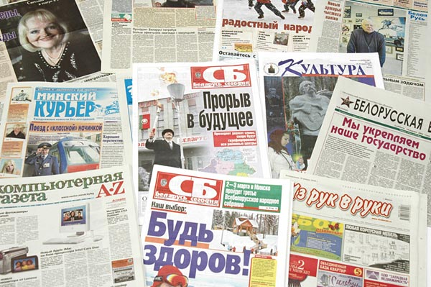
All in all, mass media help us to
form our opinion on different
events, provide us with the information
of what takes place in society ,
and are also means of entertainment.

Slide 9
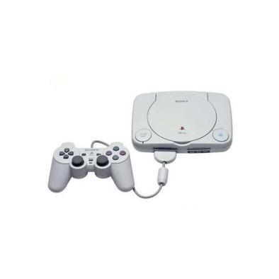
Crosswords
6
5 7
1 2
3
4

Slide 10
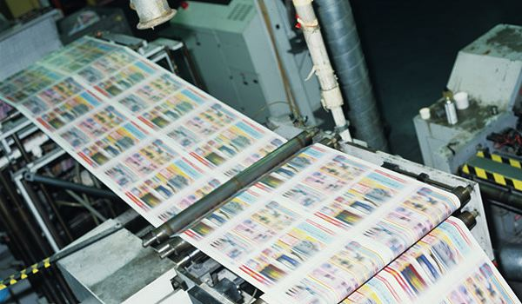
Questions
1.A business of preparing and printing books, newspapers, magazines, etc. and making them available to the public.

Slide 11
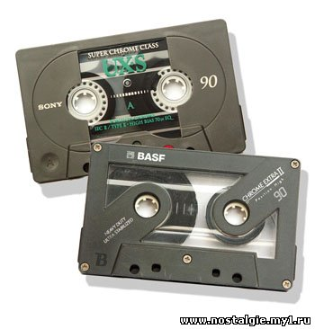
2.A cassette or a reel with tape wound round it, used for recording sounds, pictures or information.

Slide 12
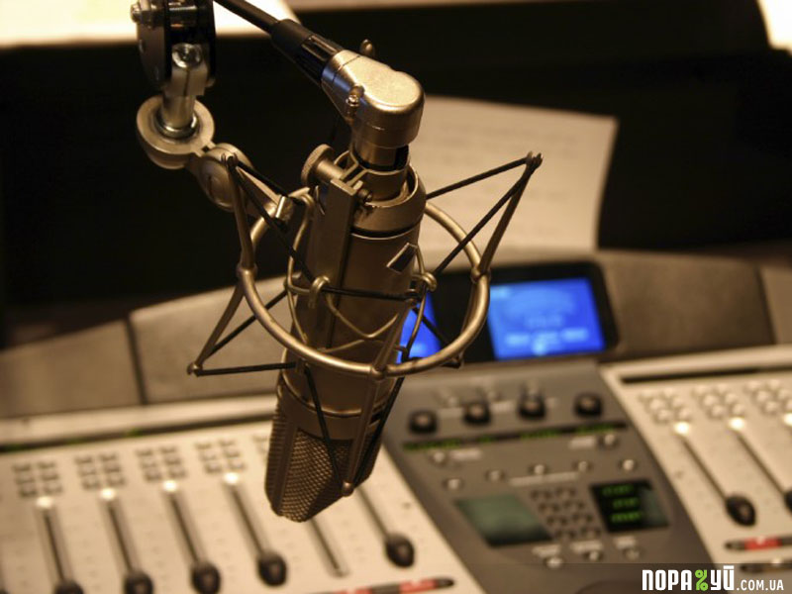
3.The sending out of programmes on radio and television.

Slide 13
4.A flat thin round object which is used for storing information or recording music.

Slide 14
5. Live Journal , the personal site on the Internet where the author publishes his comments on different topics.

Slide 15
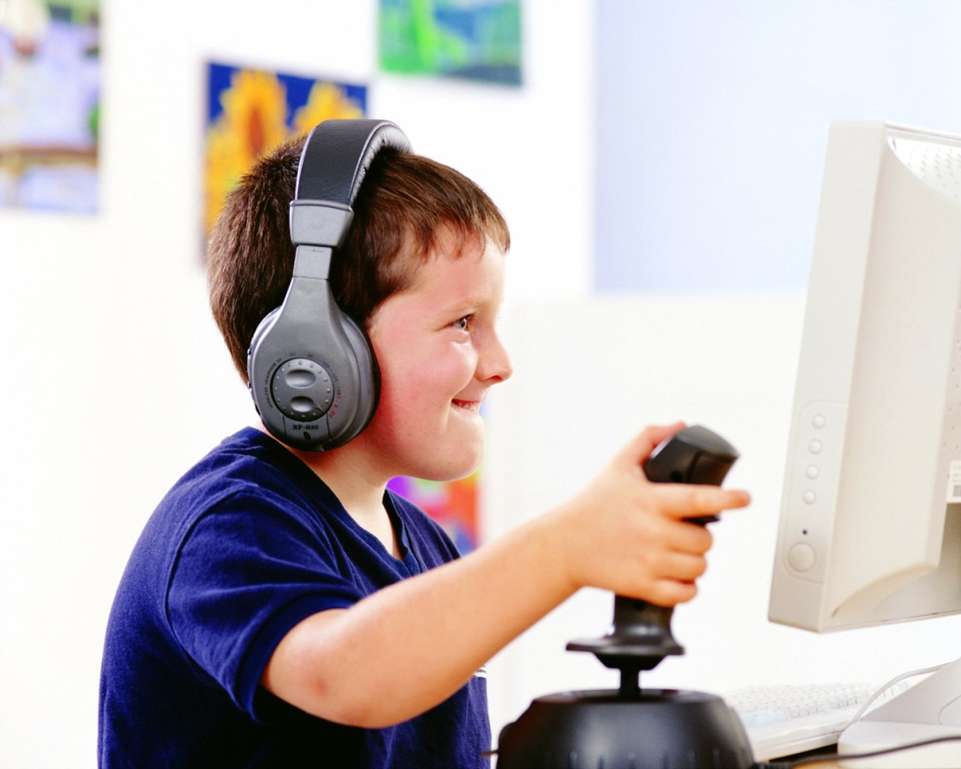
6. Games which are designed to play on the computer.

Slide 16
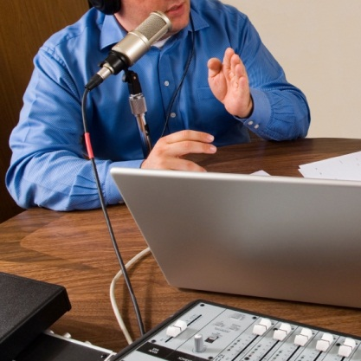
7.The automatic collection of MP-3 audiofiles different sites on the Internet.

Slide 17
Answers
1.Publishing
2.Tape
3.Broadcasting
4.Disc
5.Blog
6.Computer games
7.Podcasts

